Slide 1

Short Talk about Cloud and AI
ECV - MSP Intern
Hugo Lin
2024/03/13

Slide 2
“Because of the Cloud, We now have the Current AI.”

Slide 3
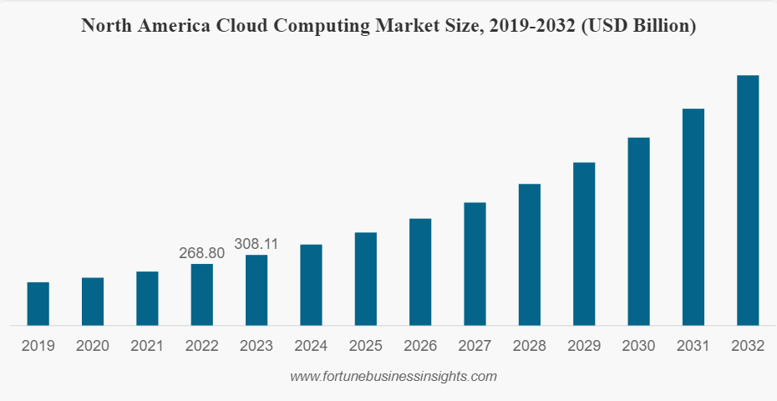

Why?
Rapidly Increasing!

Slide 4




Why?
A vast amount of DATA
Endless Computational Capacity

Slide 5
Cloud lower the threshold but doesn’t necessarily SIMPLIFY the PROCESS!

Slide 6
Thanks for your enjoying!
Represent by Hugo Lin
Notes:
QA 5分鐘

Slide 7
https://www.fortunebusinessinsights.com/cloud-computing-market-102697
Cloud and AI
Reference

